Slide 1
Cyber Security Program
Tailor-made for NEWCO

Slide 2

Vision Statement
Establish a clear operating model across IT, Security, the Business, and other control functions (Risk, Compliance, Audit)
Ensure security roles, responsibilities and reporting lines are clear and at the right level
Establish true ownership and accountability for information security controls and business protection across the Enterprise

Slide 3

Our Goals and Objective
Cyber-crime is constantly on the rise, and many smaller businesses are extremely vulnerable as a result of ineffective cyber security.
IT security solutions are essential for all kinds of businesses, particularly when you think about how important the internet and your digital systems are for your day-to-day operations.
We offer a comprehensive solution to protect against a diverse range of issues

Slide 4

Contents
Appreciation of the sensitivity of NEWCO’s information
Risk Management Strategy
Risk Tolerance Baseline
Recommendation for NEWCO’s cyber organizational structure
Continuous Monitoring Plan

Slide 5

We Understand the Value: NEWCO Information Sensitivity Structure
There are two main categories of Information:
A) NEWCO’s Internal Information
B) Client Information
NEWCO’s Internal Information consists of Employee’s private information and NEWCO’s Proprietary Information
Client Information consists of Public information, Unclassified but not authorized for public release, Sensitive but Unclassified, National Security Information (C/S/TS)

Slide 6

PURPOSE OF INFORMATION SENSITIVITY ANALYSIS
To protect and classify information from a wide range of threats, to ensure business continuity and minimize business risk
To manage and secure NEWCO’s information assets and the use made of these assets by employees and contractors who may legitimately process NEWCO’s information on behalf of the organization.
To ensure that the confidentiality, integrity and availability of the information is secured and maintained.
This will benefit: Information owners, Business process owners, IT system owners, IT system and application programmers, Security managers/information system security directors for overseeing organizations’ cybersecurity program implementation, Information system security staffs and who accept residual risk in information technology systems

Slide 7
NEWCO’S PRIVATE EMPLOYEE INFORMATION
Personal information: SSN, Address, Date of Birth, Marital Status.
Hiring Information: Job Application, Resume, Employment history, background checks, I-9 forms.
Performance Information: performance reviews, warnings and disciplinary notices, job descriptions, job changes/promotions
Compensation and benefits: Salary, bonuses, other forms of pay and benefits information
Health and Medical Information
Investigation Records: Complaints of harassments, violation of rules or policies, performance issues, safety and security issues.

Slide 8
METHODS TO SECURE EMPLOYEE’S PRIVATE INFORMATION
Be aware of their obligations under the profusion of data protection laws and regulations that govern the collection, use and transfer of personal information.
It should be noted that data privacy laws are not restricted to protecting active employee information, so companies' obligations extend to any non-employee groups such job applicants, consultants, independent contractors and terminated or retired employees.
Adopt the Health Insurance Portability and Accountability Act ("HIPAA"), covering certain health related information; the Genetic Information Nondiscrimination Act ("GINA"), which applies specifically to genetic information; and the Fair and Accurate Credit Transactions Act ("FACTA"), designed to protect consumer credit information.
Limit access to Personal Data to the extent practicable and provide training to staff who handle Personal Data; ensure third parties receiving Personal Data are subject to and apply appropriate security measures with all applicable data protection laws and regulations.

Slide 9
NEWCO’S PROPRIETARY INFORMATION
Proprietary information include trade secrets which provide great value to a business and in many cases may be a business’s greatest asset because the secret information and know-how is what allows a company to separate itself from the competition
NEWCO’s Business plans and operations
Finance and budgets
Proprietary tools, methods, formulas and growth plans
Research and development information
Sales and Marketing information

Slide 10
METHODS TO SECURE NEWCO’S PROPRIETARY INFORMATION
Adopt law to protect trade secrets from being misappropriated, which includes obtaining, disclosing, or using trade secrets without the owner’s permission.
Ensure that the employees and business partners execute a non-disclosure or confidentiality agreement, or include a non-disclosure or confidentiality provision in the employment and business agreements.
Informing all new employees of the company’s trade secret or confidentiality policy upon commencement of the employment relationship.
Clearly labeling or marking documents (including electronic versions) “confidential.”
Limiting access of suppliers or manufacturers to the specific information needed to perform their part of the work.

Slide 11
METHODS TO SECURE NEWCO’S PROPRIETARY INFORMATION
Establishing and consistently enforcing policies and practices to prevent the inadvertent disclosure of information on websites or in marketing materials
Performing exit interviews of employees, obtaining all confidential information from them, and reminding them of their obligations to keep the information confidential after their employment ends.
Being careful with the garbage – shred any information that may be secret.
Physically restricting access to confidential information by storing the information in a locked room or file cabinet, or storing it electronically in a password-protected manner.

Slide 12
CLIENT BASED INFORMATION
Client’s public information: information that is not confidential and can be made public.
Client’s confidential and sensitive information: Client media, Electronic transmissions from clients, Product information generated for the client.
Client’s National Security Information: Security clearance data (C/S/TS)

Slide 13
METHODS TO SECURE NEWCO’S CLIENT BASED DATA
Use multiple authentication layers: ensures that the right person is accessing client’s account and conducting the transaction.
Check for PCI compliance: securing Credit card payments, encrypting Client’s Information, ensures safety of Client’s information
Limit Employee access to Client data: Password-protect office computers and servers to limit access to Client data, Change passwords when employees leave the company.
Keep up with upgrades: Hackers are always looking for new ways to access data. Keep your security software up-to-date to get the most protection.
Notify clients and customers when data has been compromised.
If you move to the cloud make sure that the ability to encrypt the data – both in the cloud and also when being transferred – is on your core requirements list.

Slide 14
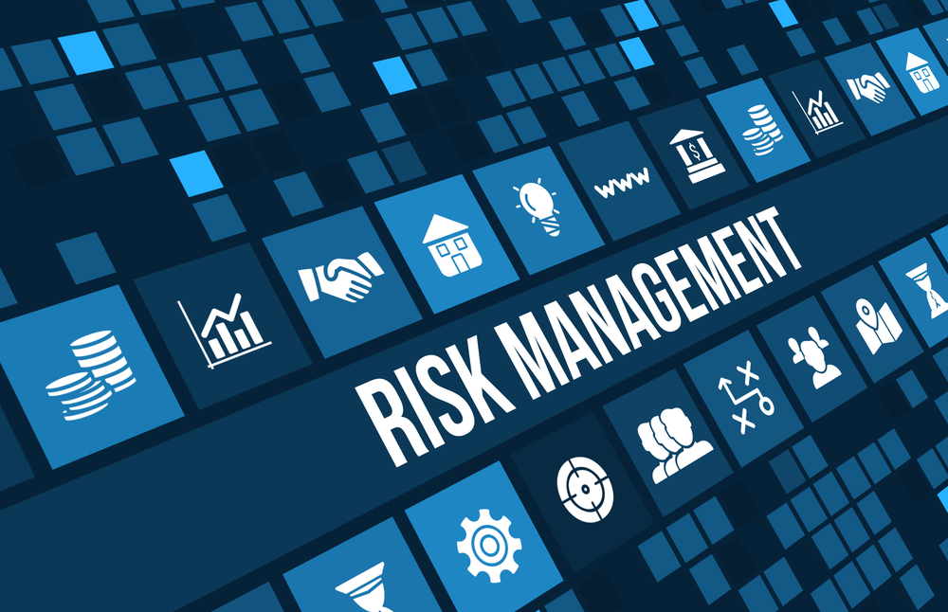
Risk Management Strategy

Slide 15
Why is risk management required?
Risk is the main source of uncertainty in any organization.
Companies increasingly focus on identifying risks and manage them before they affect the business.
Risk management is the planned and systematic approach to the identification, evaluation and control of risk.
NEWCO being a company that predominantly focuses on Federal Clients aims at maintaining low or zero risk.

Slide 16
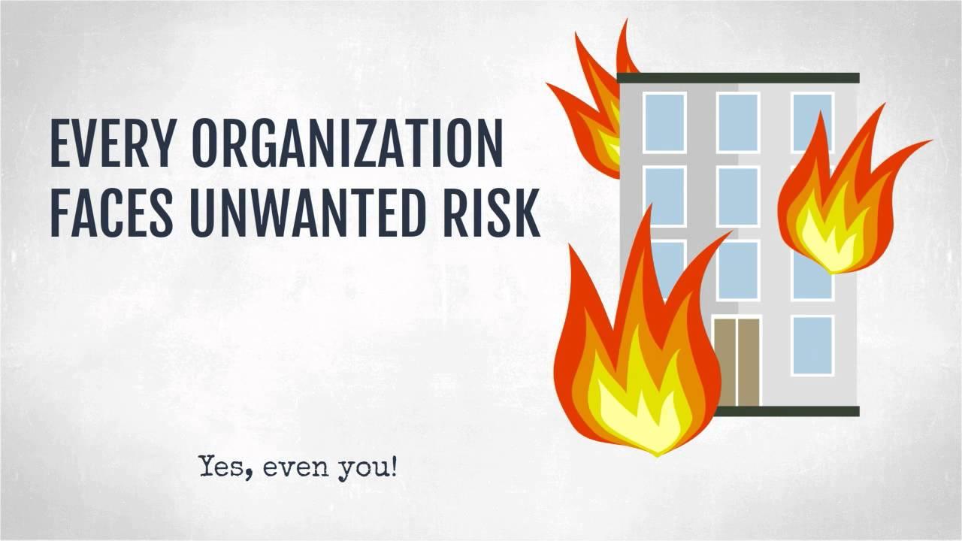
SCOPE
NEWCO maintains a corporate risk management strategy which controls risks associated with the company as a whole, its relationship with its clients and the management of new and existing business relationships.

Slide 17
Whom does Risk apply to?
All full-time, part-time, contract employees and other individuals as required by binding agreement or obligation with NEWCO who develop, acquire, deliver, use, operate, support or manage NEWCO’s information technology.
It applies to all the resources used to exploit or defend cyberspace ; it includes all networked or standalone NEWCO information technology used to receive, process, store, display, or transmit NEWCO information, as well as partnered systems where it is agreed that NEWCO standards are followed.

Slide 18

Process of Risk Management
We adopt NIST (National Institute of Security and Technology) framework.
(i) Frame risk
(ii) Assess risk
(iii) Respond to risk once determined
(iv) Monitor risk on an ongoing basis using effective organizational communications and a feedback loop for continuous improvement in the risk-related activities of organizations.

Slide 19
Risk Planning
The primary objective of Risk Planning is to prepare management responses for each of the identified threats and opportunities to reduce or remove threats which are encountered
Risk Response Categories
Avoid – typically change an aspect of the project so the threat can no longer happen
Reduce – Either reduce the chance of the threat occurring or reduce the impact of the threat should it occur
Fallback – Build a fallback plan for actions which will reduce the threat should the risk occur
Exploit – seize an opportunity to ensure the opportunity will happen and the beneficial outcome will be realized
Enhance – take actions to improve the probability of an event occurring and to enhance the beneficial outcome should it occur
Reject – a conscious decision not to exploit an opportunity as it is more economical to continue without responding

Slide 20
Risk Management – CONOPS
NEWCO’s Risk Management governance structure will be designed to address risks at System(managed), Operational(balanced) and Enterprise(governed) Levels.
Cyber Risk to NEWCO IT is actively assessed and managed at the individual IT, Control System and Platform System level.
Implement guidance from higher Tiers into each phase of individual Systems’ Development Life Cycles.
Monitor their systems’ cybersecurity performance. Develop metrics/performance measures; take measurements, make control adjustments, and report status to Tier 2 on a continuous basis
Cyber Risk to NEWCO operations are managed at the Director level.
Design, develop, and implement NEWCO’s mission/business processes that support missions and functions defined at Tier 1.
Based on cyber risk inputs from Tier 3, develop a risk response strategy to address the balance between NEWCO’s mission accomplishment and cyber risk.

Slide 21
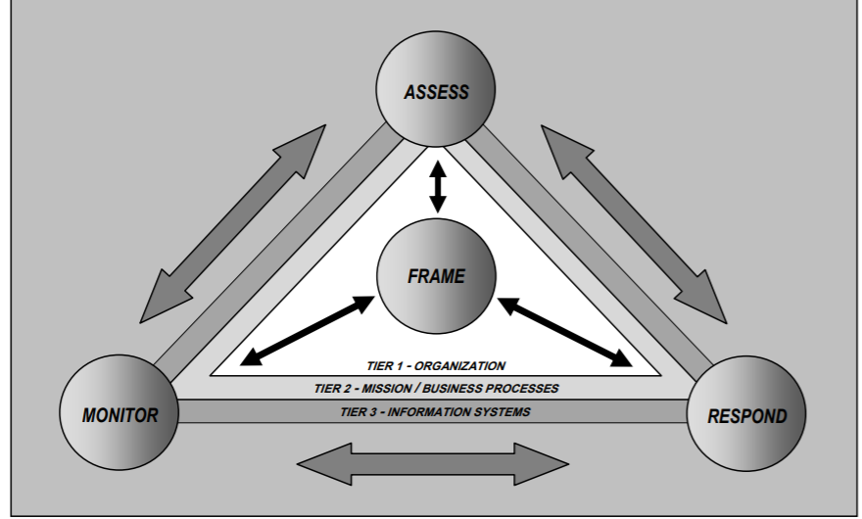
Risk Management – CONOPS
Cyber Risk Management activities are governed at the CISO/CIO level , the senior leaders must determine NEWCO’s risk tolerance and reflect this in NEWCO’s policy and investment decisions.
Establish governance structures and processes to provide strategic direction, ensure that [Organization] missions and business objectives are achieved; risks are identified and proactively managed, and ensuring that NEWCO’s IT and cybersecurity resources are employed efficiently and responsibly.

Slide 22
Risk Tolerance Baseline: Risks that cannot be tolerated
Development risk: If the project fails and outputs are not achieved
Physical Security risks: Unsafe environment to operate.
Cyber Security Risk: Cyber criminals attacking the Organization.
Reputational risks: Cross-cutting risks not fully addressed (gender, environment, climate change) or a scandal with a partner.
Business Risk: Copyright Infringement
Notes:
Business comes first and any risk to it cannot be tolerated

Slide 23
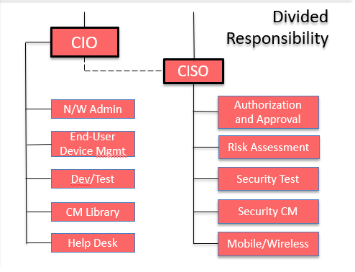
ROLE STRUCTURE
Both CIO and CISO individually report to the CEO, however, CISO is still connected to CIO to discuss and get approvals

Slide 24
Continuously Monitoring Risks
Key concepts:
Maximum automation.
Monitor continuously (as in constantly – not periodically or episodically).
Develop/provide a Common Operating Picture.
Maximize communications between tiers 1, 2 and 3.

Slide 25
Budgeting and Risk Management for the next 3 years
 | Year 1 | Year 2 | Year 3 | Year 4
Preventive Control | 40% | 20% | 20% | 35%
Detective Control | 20% | 30% | 30% | 30%
Reactive Control | 20% | 30% | 25% | 20%
Protective Control | 20% | 20% | 25% | 15%

Slide 26
Continuous Monitoring: Plan Goal
The main goal is to maintain ongoing awareness of information security, vulnerabilities, and threats to support organizational risk management decisions

Slide 27
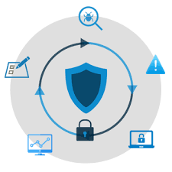
Objectives of Continuous Monitoring
Establish an ISCM program
Implement the ISCM program
Analyze and Report findings
Respond to findings
Review and Update ISCM strategy and program

Slide 28

Rather than enforcing a static, point-in-time reauthorization process, NEWCO shall conduct ongoing authorizations of their information systems and environments in which those systems operate, including common controls, through the implementation of their risk management programs.

Slide 29
Information Flow and Principle Authorities of ISCM
The bottom-up (from Tier 3 to Tier 1), top-down (from Tier 1 to Tier 3) approach ensures information flows up to leadership when new risk is discovered, down when new weaknesses or vulnerabilities must be validated, and laterally to facilitate risk management across all systems.
Tier 1 – Top Management Executives
Tier 2 – Operational Managers and Security Owners
Tier 3 – System, Security Engineers and Administrators

Slide 30
Principle Roles
Tier 1 authorities:
CISO (Chief Information Security Officer):
Maintaining an agency-wide NEWCO ISCM Strategy and Program.
Acquiring or developing and maintaining automated tools to support ISCM and ongoing authorizations.
CIO (Chief Information Officer):
Reviewing continuous monitoring reports/dashboard and making a risk-based determination on a system’s ongoing authorization status.
Ensuring the organization’s ISCM program is applied with respect to a given information system.

Slide 31
Principle Roles
Tier 2 authorities:
ISSM (Information System Security Manager):
Responsible for ensuring proper protection or corrective measures have been taken when an incident or vulnerability has been discovered.
Responsible for maintaining System Security Plans and all documentation associated with Continuous Monitoring Plan.
ISSO (Information System Security Owner):
Ensuring required continuous monitoring controls and settings are in place and operating in accordance with NEWCO and Federal policies and requirements.
Assisting in remediation activities as necessary to maintain ongoing authorization.

Slide 32
Principle Roles
Tier 3 authorities:
SE & SA (Security Engineers and System Administrators):
Ensuring required continuous monitoring controls and settings are in place and operating in accordance with NEWCO and Federal policies and requirements.
Maintaining required continuous monitoring documentation.
Reviewing continuous monitoring reports/dashboard and responding, as necessary, to maintain a system’s ongoing authorization.
Assisting in determining whether a breach or information system change requires an event-driven reauthorization

Slide 33
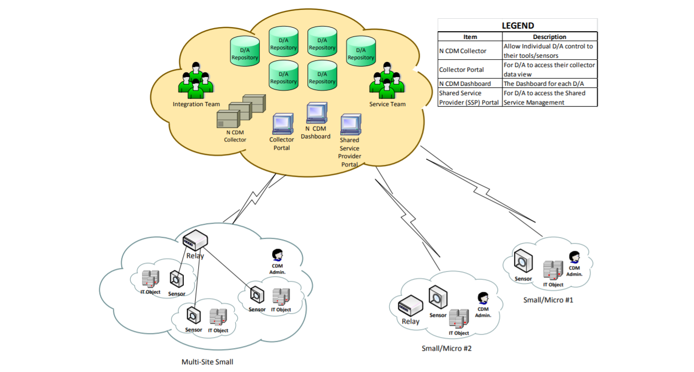
Concept of Operations

Slide 34
Concept of Operations
Continuous monitoring involves both automated and manual tasks at all three levels - system, operational and physical level.
However, automated processes including the use of automated support, can make the process of continuous monitoring more cost-effective, consistent, and efficient.
Both Internal and External Information are to be continuously monitored. Internal Aspects can be accomplished through Security Testing and System Monitoring. External Aspects is accomplished by the ISSM by reviewing such things as the NVD, the CWE, the OWASP Top 10 Vulnerabilities and the SANS Cyber Defense Reports among others.
To improve the Continuous monitoring plan in NEWCO, a well-defined Security Lifecycle Management implemented to provide overall ISCM Health checks and improvisation

Slide 35
Information Flow and Decision Points
A feedback mechanism is necessary ensure agency information systems continue to perform in accordance with its ISCM Plan as approved by the Tier 1.
The Tier 2 will provide semiannual status reports to the Tier 1 on system performance with the ISCM program. The status reports provide information which can be used to measure performance related to the commitments made in the system’s ISCM Plan.
The report will track submission of required ISCM deliverables to the Tier 2 and continued effectiveness of ISCM/CDM automated capabilities for each information system (as applicable).

Slide 36
Tools and Mechanisms
At System Level:
Monitoring the system for anomalous activity
Testing the application’s security capabilities at a predetermined interval and for configuration changes
Analyzing and validating the metrics of the monitored results obtained from IT enabled dashboards of the automated tasks

Slide 37
Tools and Mechanisms
At operational and enterprise level:
Paper based data and other evidences from processes and transactions such as manual reviews of exception reports and real-time approval of transactions by Security Managers.
Continuous Auditing process using advanced analytical tools to automate the auditing plan to extract and analyze data and specified intervals.
Monitoring the threat environment to identify trends, new weaknesses or vulnerabilities, and changes in threats.

Slide 38
Continuous Monitoring Dashboard
Include 3 Interfaces: Tier 1, Tier 2, Tier 3
Tier 1 interface:
A high-level view displays the top continuous, or long-term, events detected on the network in the last 5 days. The table is sorted so that the continuous events detected most often are at the top.
Tier 2 interface:
This view displays the top large event anomalies, or spikes, detected on the network in the last 72 hours. The table is sorted so that the anomalies detected most often are at the top. This view also has a continuous monitoring assessment matrix which assists the organization in monitoring changes on its network.
Tier 3 interface:
A further detailed view with all the necessary views for displayed every 12 hours. All events or anomalies are alerted by Red flashes and SOC analysts and System admins are responsible to check on timely manner and take necessary remediation.

Slide 39
Recommendations: What to do next?
The Administration should focus on, and recommend, long-term authorization and sufficient appropriations for, high-quality, effective cybersecurity education and workforce development programs in its budget proposals in order to grow and sustain the cybersecurity workforce.
Emphasizing and expanding opportunities for retraining so that current employees as well as displaced workers and veterans can be reskilled to take on cybersecurity roles.
Using virtual training and assessment environments and improve assessment tools that match candidates with the skills and knowledge needed to succeed in the workforce and as lifelong learners.
Providing greater financial assistance and other incentives to subsidize cybersecurity education and training costs to employees.

Slide 40

Conclusions
Our cybersecurity program focused on offering a comprehensive solution to protect against a diverse range of issues.
The future of cybersecurity will in one sense be like the present: hard to define and potentially unbounded as digital technologies interact with human beings across virtually all aspects of politics, society, the economy, and beyond.
We have tried to stretch imaginations just enough to see over-the-horizon glimpses of how the problem set will shift and what new opportunities will arise.

Slide 41
Thank you

